Slide 1

Predictive Sales Analytics
Forecasting and Optimization with Machine Learning
Author: Ramesh Talapaneni
Notes:
* Today I’ll be presenting on Predictive Sales Analytics—how forecasting and optimization using machine learning can enhance business decision-making.
* We’ll walk through the importance of sales forecasting, the dataset used, key findings, and future directions.

Slide 2

Agenda
Importance of Sales Forecasting
Business Problem
Dataset & Methodology
Exploratory Insights
Predictive Modeling
Challenges & Ethical Considerations
Key Findings
Future Directions
Notes:
* Sales forecasting is crucial for businesses as it helps in resource allocation, demand planning, and pricing strategies.
* Accurate forecasts reduce inefficiencies in inventory management and operations.
* However, challenges like seasonal fluctuations, external market influences, and forecasting errors can lead to revenue loss.

Slide 3

Introduction and Business Problem
Why Sales Forecasting Matters?
Guides resource allocation and demand planning
Aids in pricing strategies and inventory management
Reduces operational inefficiencies
Challenges:
Complex trends and seasonal fluctuations
Impact of external market influences
Risk of poor forecasting leading to revenue loss
Notes:
The dataset for this study is sourced from Kaggle, containing sales transactions with attributes like product codes and weekly sales.
The business problem revolves around predicting sales trends to optimize decision-making.
Key preprocessing steps include handling missing data, feature engineering, and data normalization.

Slide 4
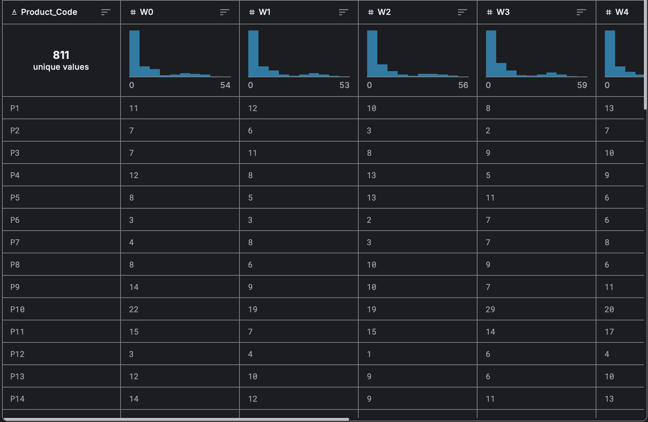
Dataset Overview
Source: Kaggle – Sales Transactions
Key Attributes:
Product Code (unique identifier)
Weekly Sales (W0–W51)
Normalized Sales (42-51)
Data Preprocessing:
Handling missing values (imputation)
Feature engineering (total/average sales, normalized sales)
Scaling & normalization for consistency
Notes:
To ensure meaningful insights, we conducted Exploratory Data Analysis (EDA) to detect trends, seasonality, and anomalies.
Model selection included Linear Regression, Random Forest, Gradient Boosting, XGBoost, and ARIMA.
Hyperparameter tuning helped balance accuracy and computational efficiency.
ARIMA was specifically used for time series forecasting, capturing long-term patterns.

Slide 5

Methodology
Exploratory Data Analysis (EDA): Identifying trends, seasonality, and anomalies
Model Selection: Linear Regression, Random Forest, Gradient Boosting, XGBoost, ARIMA
Hyperparameter Tuning: Balancing accuracy vs. computational cost
Time Series Forecasting: ARIMA to capture seasonal and long-term trends
Notes:
A look at the weekly sales distribution revealed stable median sales across weeks.
However, we observed high variability in certain weeks, suggesting fluctuations in demand.
Outliers were detected, with weeks 24 and 25 showing significant spikes—likely due to seasonal effects or promotions.

Slide 6
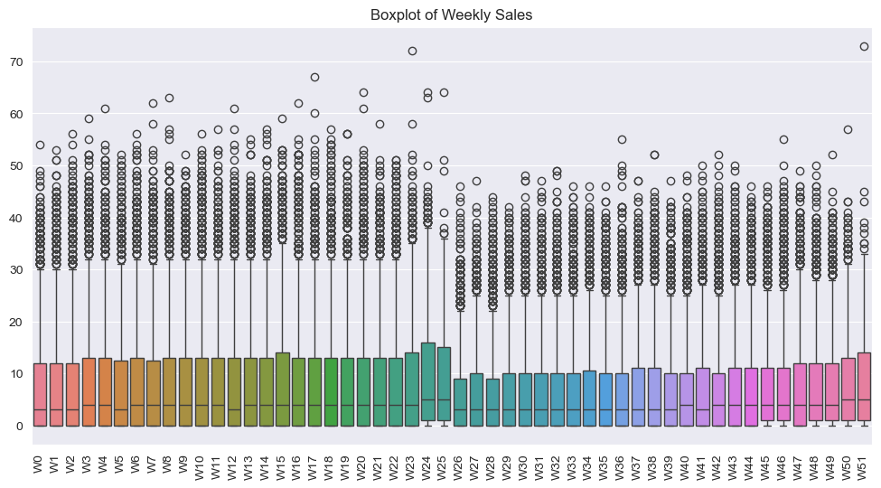
Exploratory Insights – Weekly Sales Distribution
Consistent Median Sales: Weekly sales show a relatively stable median across weeks.
High Variability: Some weeks exhibit wider interquartile ranges, indicating fluctuations in sales volume.
Outliers Present: Significant number of extreme sales values (outliers), highlighting occasional spikes.
Weeks 24 & 25 Noticeable Increase: Sales show a visible jump during these weeks, suggesting potential seasonality or promotional effects.
Notes:
This heatmap helps us understand correlations between different weeks.
Strong self-correlation along the diagonal is expected.
Dark blue areas indicate low correlation, suggesting distinct sales patterns.
Brown areas show moderately high correlation, implying similar sales trends in certain weeks.

Slide 7
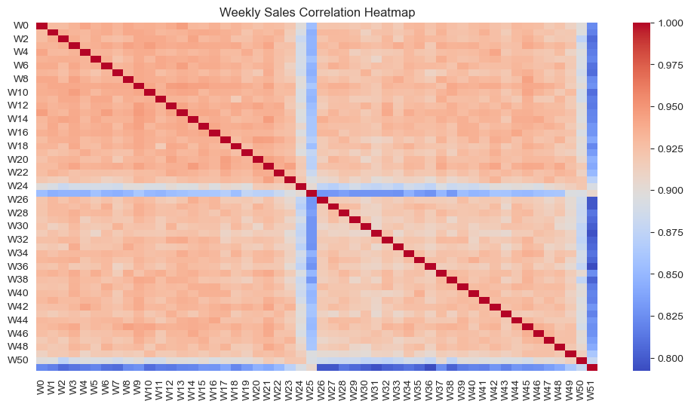
Exploratory Insights – Correlation Heatmap
Diagonal Line: Strong self-correlation along the diagonal (expected).
Dark Blue Areas: Potential negative or low correlation between specific weeks.
Brown Areas: Indicate moderately high correlation, suggesting similar sales patterns in those weeks.
Notes:
To evaluate model performance, we used key metrics like Mean Absolute Error (MAE), Root Mean Squared Error (RMSE), and R² score.
Linear Regression had the lowest MAE and RMSE but lacked strong predictive power.
Random Forest offered a good balance of accuracy and interpretability.
Gradient Boosting performed best, while XGBoost required further tuning due to higher errors.

Slide 8
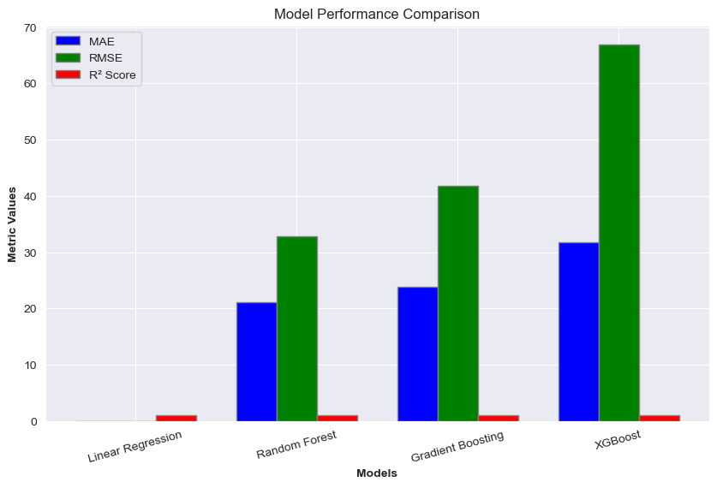
Predictive Modeling – Model Performance
Performance Metrics:
Mean Absolute Error (MAE)
Root Mean Squared Error (RMSE)
R² Score
Model Comparison Results:
Linear Regression – Lowest MAE & RMSE, but lower predictive power
Random Forest – Strong balance of accuracy and explainability
Gradient Boosting – Best performance overall
XGBoost – High errors, needs tuning
Notes:
Data quality issues like missing or inconsistent records posed challenges.
Feature selection was critical to avoid overfitting and improve generalizability.
Ethical considerations include ensuring data privacy and security.
Bias in predictive models must be addressed to ensure fair decision-making.
Transparency in AI-driven decisions is essential for business trust."

Slide 9

Challenges and Ethical Considerations
Challenges:
Data quality issues (missing/inconsistent sales records)
Feature selection complexity
Risk of model overfitting
Ethical Considerations:
Data privacy & security
Bias mitigation in predictive modeling
Transparency in decision-making
Notes:
Machine learning significantly improves sales forecasting accuracy.
Feature engineering and time series analysis play a crucial role in enhancing predictions.
Future research should explore additional data sources for even more robust forecasting.

Slide 10

Key Findings
Machine learning improves sales forecasting accuracy
Feature engineering and time series analysis enhance predictions
Future research can integrate additional data sources for better results
Notes:
For businesses, predictive analytics enables better inventory management.
It also improves marketing campaign targeting by predicting demand patterns.
Additionally, companies can enhance revenue planning with more accurate sales projections.

Slide 11

Conclusion – Practical Application
For Businesses:
Improved inventory management
Better marketing campaign targeting
Enhanced revenue planning
Notes:
Next steps include integrating external factors like economic indicators and sentiment analysis.
Deep learning techniques such as LSTM networks can further refine predictions.
Expanding the dataset to include international markets will provide broader insights for global business strategies.

Slide 12

Future Directions
Next Steps:
Integrate external factors (economic indicators, sentiment analysis)
Explore deep learning techniques (LSTM networks)
Expand dataset to include international markets for broader insights
Notes:
Thank you for your time and attention.
I’d be happy to take any questions or discuss potential improvements in predictive sales analytics.

Slide 13
Thank You

